Slide 1
A College-Going Culture
Relevant Academy of Eaton County
December 14, 2015

Slide 2
College Readiness Efforts
My goal is to support our school’s current college readiness efforts and introduce new programs so all our students make it successfully through the college-going process. I am here to support the transition from high school to postsecondary education.
According to the Georgetown Center on Education and the Workforce, by the year 2020 68% of the jobs in Michigan will require postsecondary education.

Slide 3
Focused Attention to Meet Student Needs
Having a dedicated college adviser assisting staff provides more time to work directly with students to ensure they are taking the steps necessary to graduate high school and prepare for college.

Slide 4
What is College?
When we use the term “college” we are referring to any postsecondary training that leads to a degree or certificate. This includes:
Community College
Public/Private Four-year Universities
Certificate Programs
Apprenticeship Programs
Trade and Technical Programs
ROTC Programs

Slide 5
College Readiness Activities
Recent Events:
College Recruiter Visits
Military Recruiter Visits
One on One Meetings with Students
Financial Aid Presentation from Olivet College
College Visit to Baker College
College Application Week
College Prep Materials Passed Out
Ask Me About It Signs
Upcoming Events:
Student Survey
College Cash Campaign
FAFSA Completion Events with Olivet College and KCC
Decision Day Celebration
End of Day College Completion Activities

Slide 6
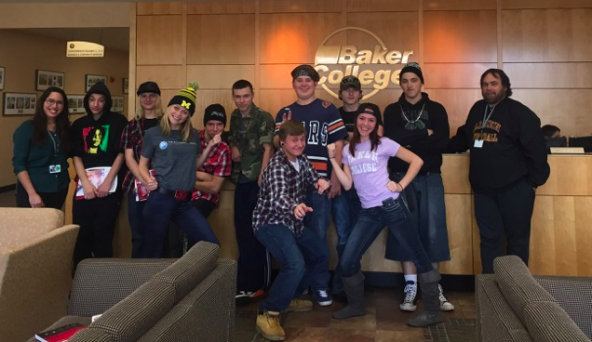
Baker College Visit

Slide 7
College Application Week Oct. 26-30
Tuesday:
Complete college applications in the morning- Olivet College present to help
Lansing Community College presentation in the afternoon
College themed pumpkins were painted as 2-2:30 activity
Wednesday:
College themed Bingo was played, prizes awarded
Thursday:
Complete college applications in the morning- Davenport University present
College themed pumpkins were painted and College Jeopardy was played as 2-2:30 activities

Slide 8
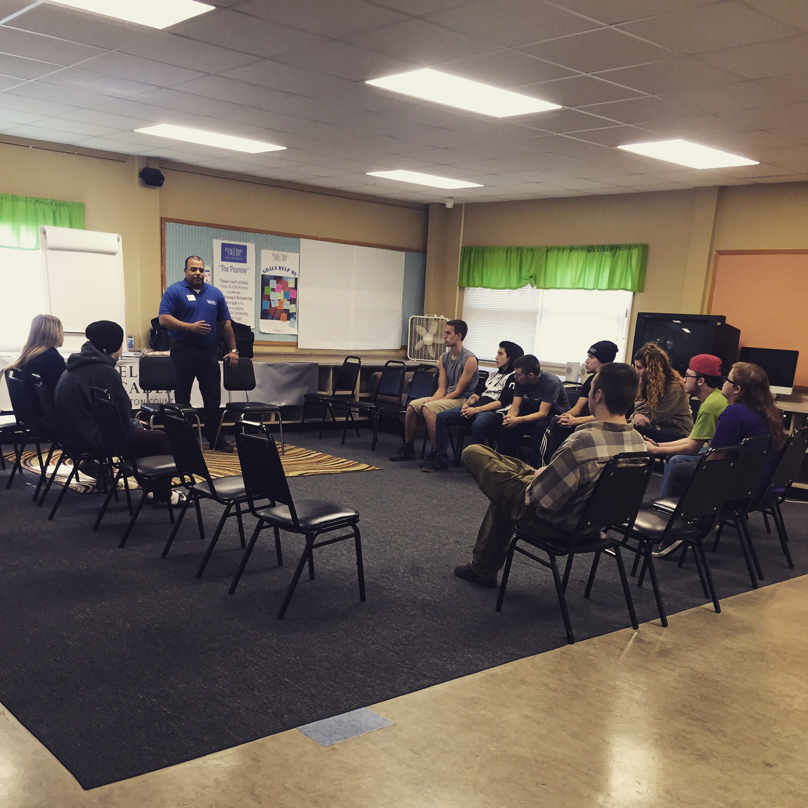
Lansing Community College Recruiter Visit

Slide 9
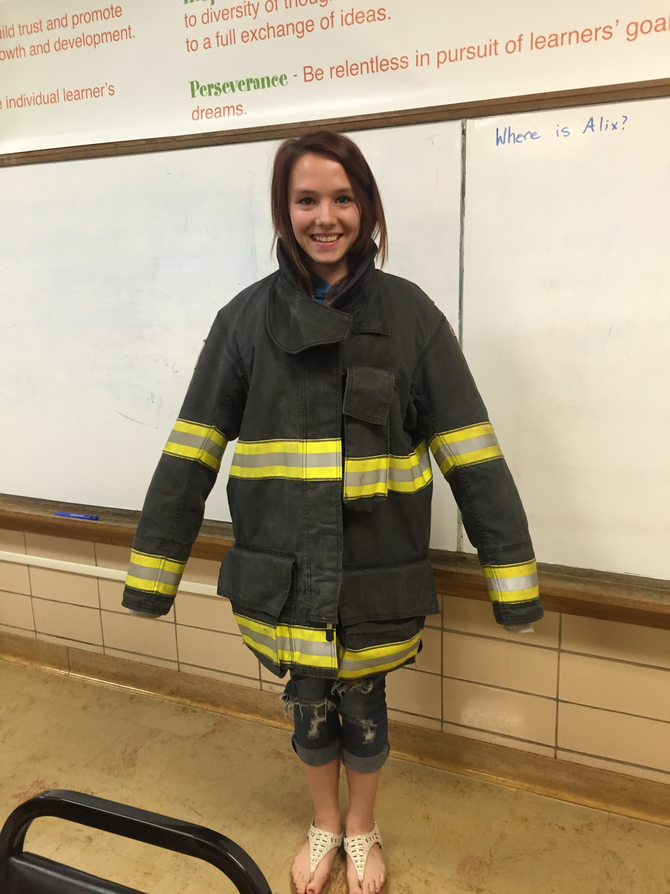
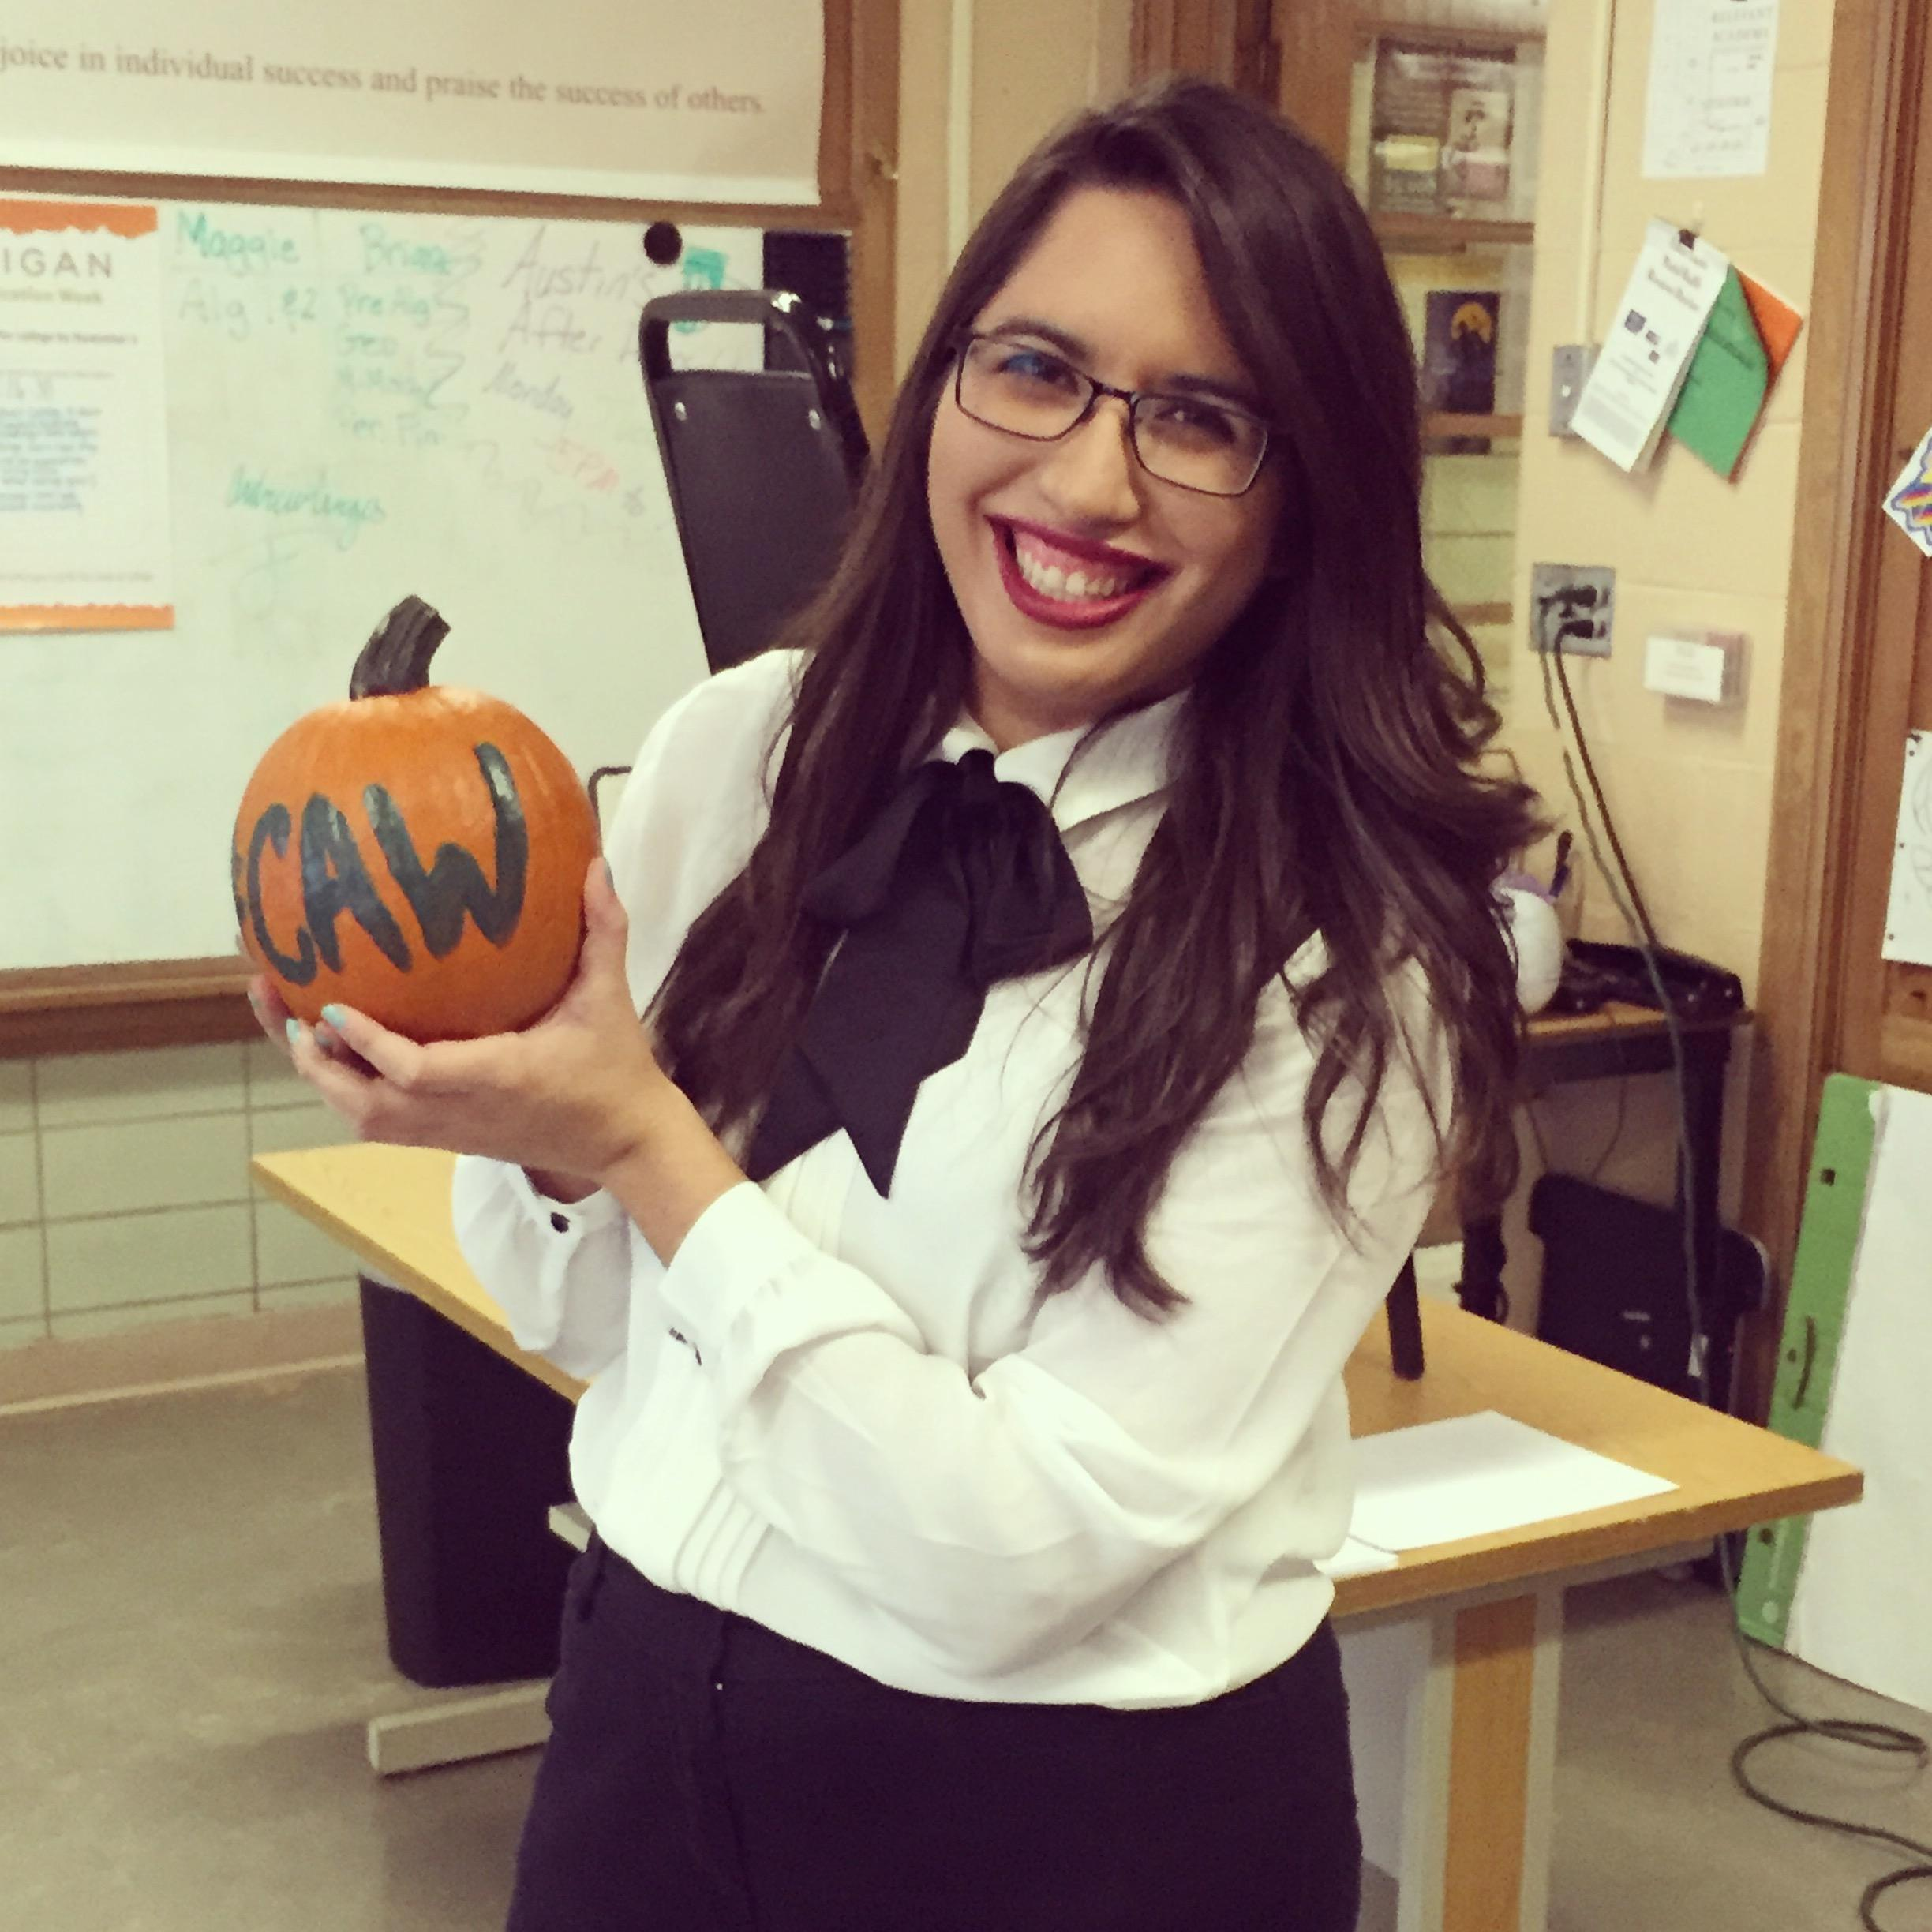
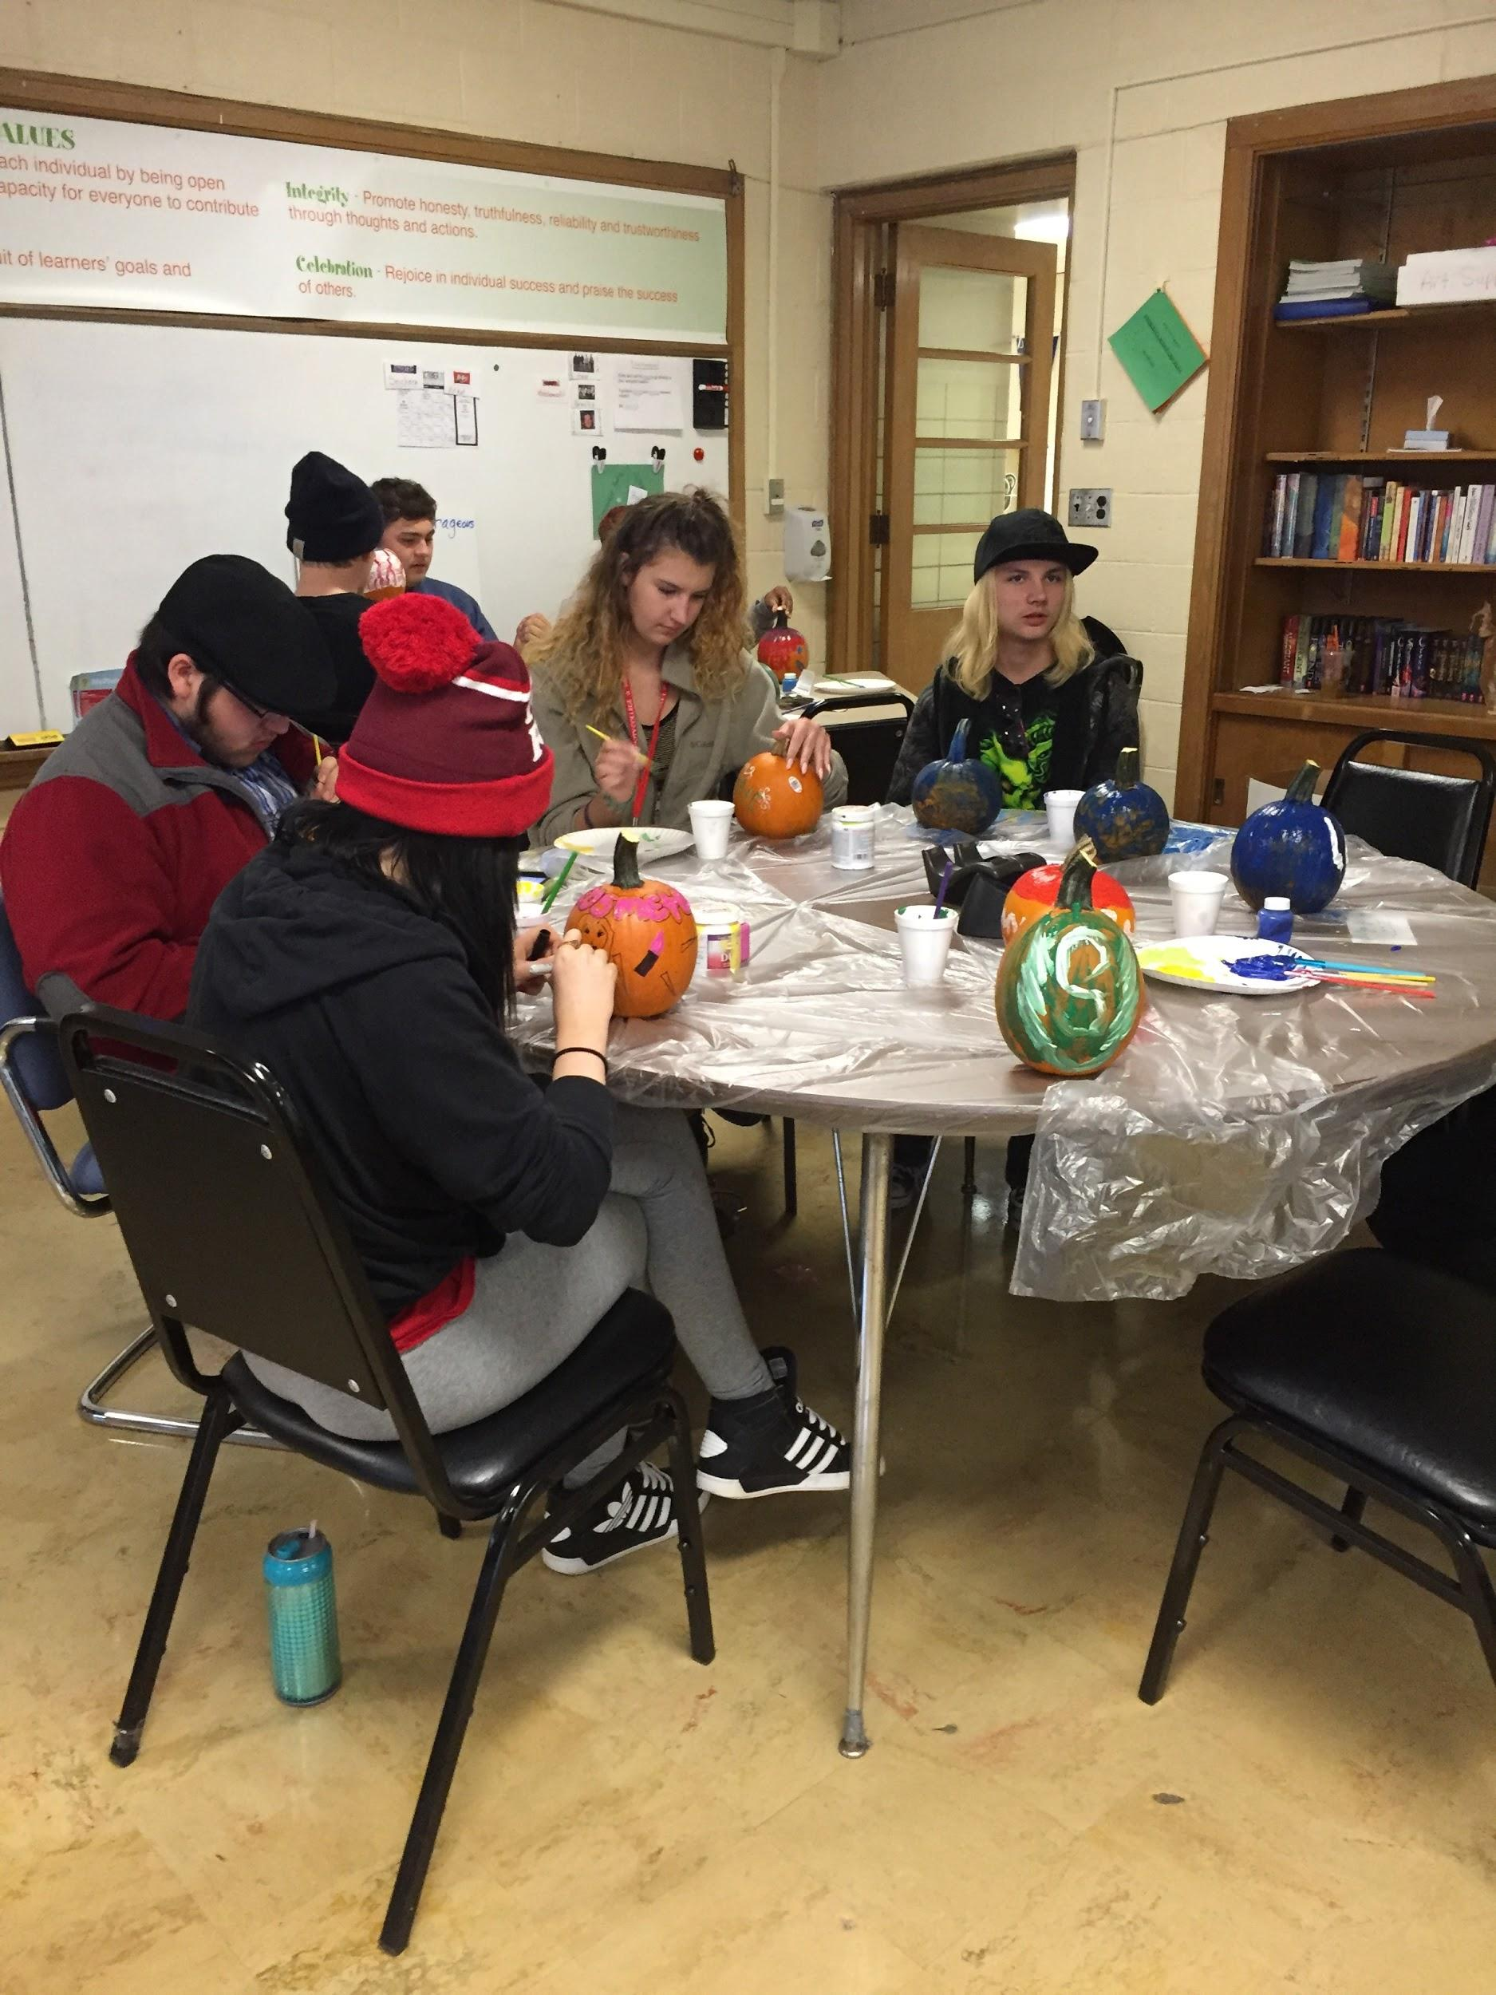

Slide 10
College Cash Campaign
The Michigan College Cash Campaign is an initiative to encourage students to complete the FAFSA as part of the college-going process. This campaign runs from February to April, straddling Michigan’s March 1 FAFSA deadline.
Dec. 1: Financial Aid Presentation from Olivet College
Jan/Feb: Financial Aid Presentation from Davenport University, time set aside during the school day for students to work one-on-one with the college adviser to complete the FAFSA
Feb: FAFSA Presentation from Olivet College

Slide 11
Decision Day
The goal of College Decision Day is to recognize high school seniors for their postsecondary educational plans and encourage younger students and families to prepare early for postsecondary education. College Decision Day is held annually on or around May 1 and is designed to coincide with the date that most seniors must inform a college of their plans to enroll.

